Slide 1
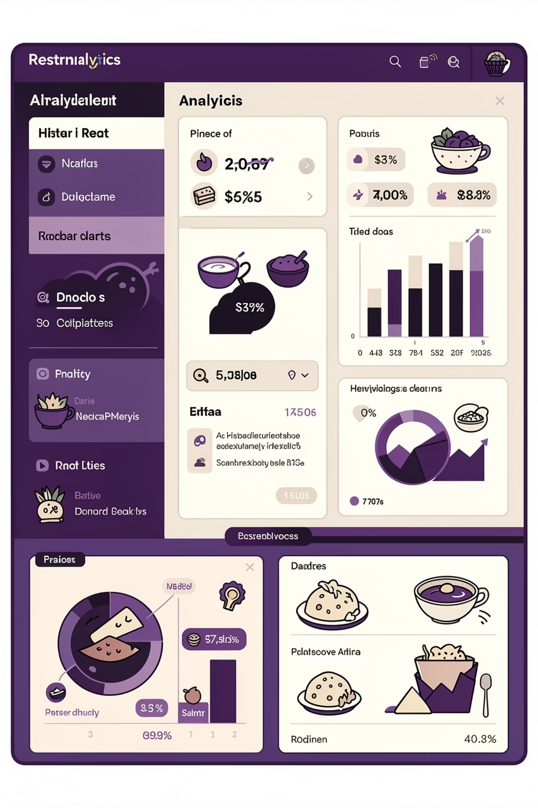
Food Trends: Understanding Customer Preferences Through Data
Infosys Springboard Virtual Internship 6.0
Domain: Data Analytics & Visualization (Power BI)
Batch -11 , Team - C
Vaishnavi Shah
Mentor :- NityaShree Mam

Slide 2






Project Objective
Understand Food Trends
Customer Engagement
Analyze customer preferences across cuisines, cities, and restaurant chains globally
Study ratings and votes to measure customer satisfaction and loyalty
Pricing Impact
Service Analysis
Evaluate how pricing strategies influence customer perception and behavior
Assess online delivery and table booking impact on restaurant performance
Risk Detection
Strategic Insights
Identify quality inconsistencies and recommend improvement opportunities
Transform data findings into actionable business recommendations

Slide 3
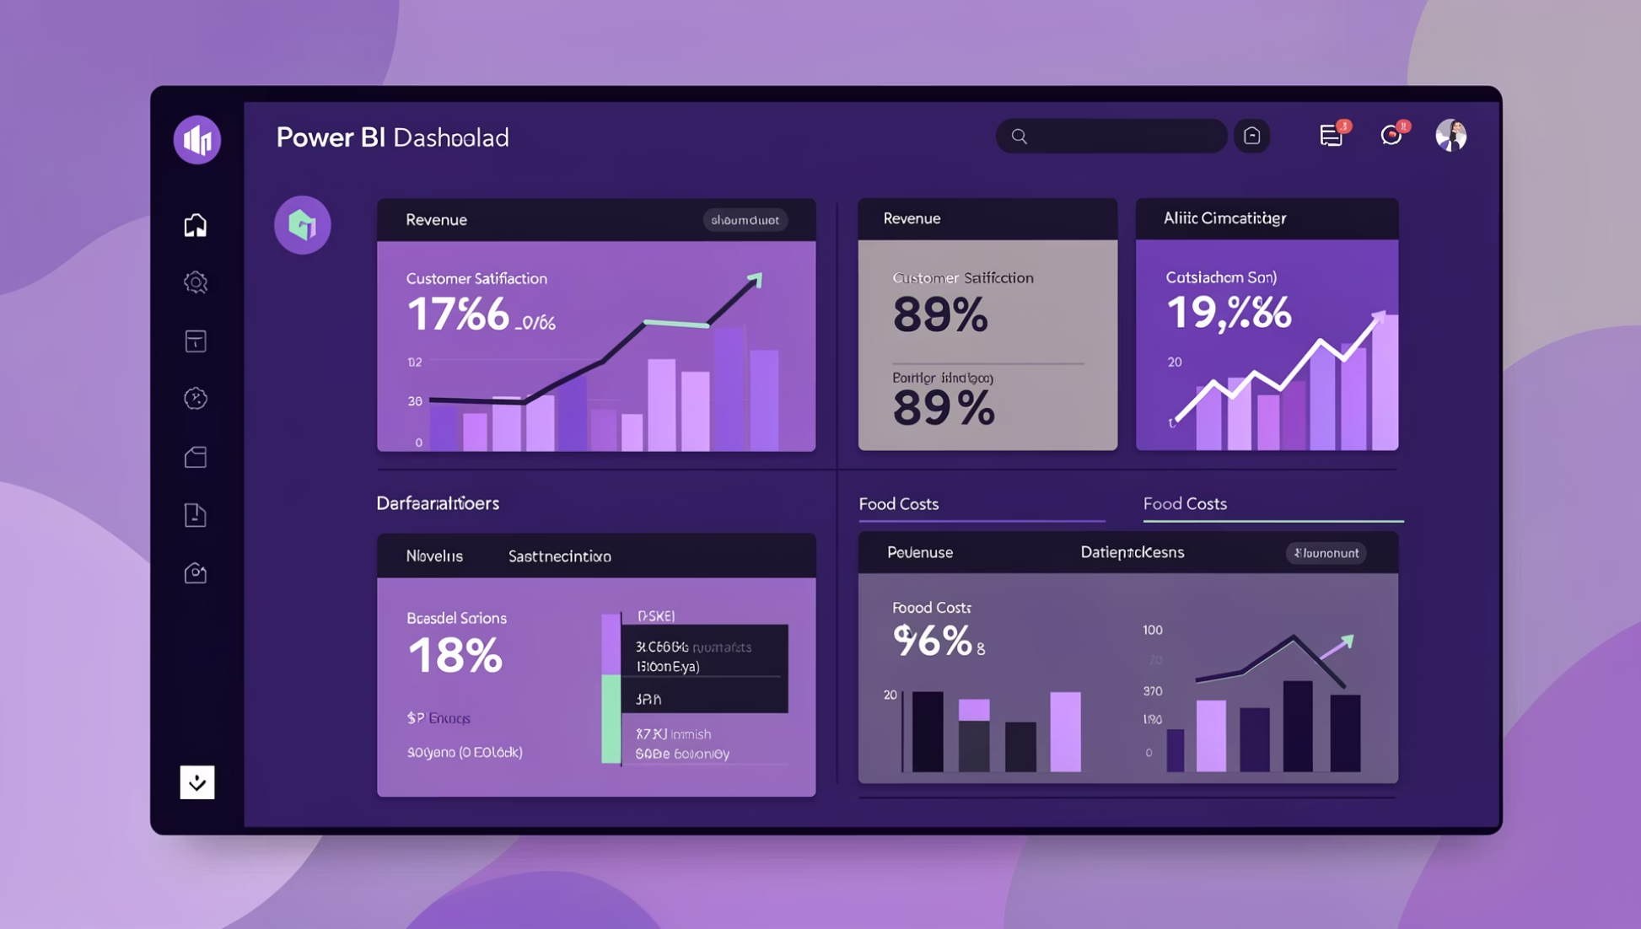
Project Overview
What We Analyzed
The Food Trends Analysis project explores comprehensive restaurant data to uncover market patterns and customer behavior. We examined global market presence, cuisine demand, pricing strategies, and service availability to deliver strategic insights.
How We Delivered
Interactive Power BI dashboards transform raw data into visual stories, enabling stakeholders to make informed decisions through intuitive exploration and analysis.

Slide 4
Top Visualizations Used
1
2
3
Bar Charts
Donut Charts
Scatter Plot
Compare restaurant counts, cuisines, cities, and action categories. Identify top performers and underperforming segments.
Show percentage distributions for rated vs. unrated restaurants and online delivery availability.
Analyze relationship between votes and ratings. Detect anomalies like high ratings with low votes.
4
5
Line Chart
Tables
Display rating stability across vote buckets. Demonstrate reliability with higher engagement.
Provide restaurant-level details for drill-down analysis and actionable insights.

Slide 5
Project Execution Timeline
Milestone 2: Market & Cuisine Analysis
Milestone 1: Data Foundation
Dashboards 1–3: Market presence, coverage, cuisine demand, and customer engagement patterns
Activities: Dataset sourced from Kaggle, cleaned and transformed using Power Query Editor
Focus: Global market presence and cuisine popularity trends
Focus: Key dataset columns analyzed and validated for accuracy
Milestone 4: Quality & Strategy
Milestone 3: Pricing & Service Impact
Dashboards 6–7: Restaurant consistency, quality stability, and strategic prioritization
Dashboards 4–5: Pricing strategy perception and service availability convenience impact
Focus: Quality consistency and strategic prioritization for business actions
Focus: Influence of pricing and services on restaurant performance

Slide 6
Challenges Faced & Resolutions
Challenges Encountered
Solutions Implemented
Handling multiple currencies for cost analysis
Creating meaningful vote and rating buckets
Avoiding repetition across dashboards
Maintaining clarity with large datasets
Translating analytics into business-friendly insights
Used interactive slicers instead of currency conversion
Applied DAX logic for structured categorization
Designed dashboards with unique objectives
Focused on storytelling over raw numbers
Developed risk detection frameworks

Slide 7






Skills & Technical Learnings
Data Transformation
DAX Calculations
Mastered Power Query for cleaning, transforming, and preparing datasets for analysis
Created calculated columns and measures using DAX for advanced analytical logic
Dashboard Design
Advanced Features
Built interactive dashboards with business-focused storytelling and user experience
Implemented slicers, cross-filtering, and drill-down analysis for deeper insights
Risk Detection
Behavior Analysis
Developed analytical frameworks to identify quality inconsistencies and risks
Enhanced understanding of customer preferences, engagement patterns, and decision drivers

Slide 8
Key Insights Discovered
Rating Reliability
Premium Quality
Delivery Impact
Restaurants with higher vote counts show more stable and reliable ratings
Premium-priced restaurants consistently receive better customer ratings
Online delivery availability significantly increases customer engagement and accessibility
Visibility Gap
Action Framework
Many high-quality restaurants lack proper visibility and marketing presence
Action-based categorization simplifies strategic decision-making processes

Slide 9
Future Enhancements & Conclusion
Future Enhancements
Project Impact
This project demonstrates how data analytics transforms raw restaurant data into strategic business intelligence. The comprehensive dashboards provide a 360-degree view of market dynamics, customer preferences, and operational performance.
Sentiment Analysis
Extract emotional insights from customer reviews using NLP
Data-driven insights enable better decision-making and identify growth opportunities while mitigating quality risks.
Time-Based Trends
Analyze seasonal and temporal patterns in food preferences
Predictive Modeling
Forecast restaurant performance using machine learning algorithms

Slide 10


Acknowledgements & References
Infosys Springboard Team
Project Mentor
Team Collaboration
For organizing this valuable internship opportunity and providing the platform for professional growth
For continuous guidance, constructive feedback, and technical expertise throughout the project
For collaboration, encouragement, and shared insights that enriched the learning experience
References: Microsoft Power BI Documentation • Infosys Springboard Virtual Internship Course Materials

